Slide 1
1.3 Asocjacja

Slide 2
An Association specifies a semantic relationship that can occur between typed instances. It has at least two memberEnds represented by Properties, each of which has the type of the end. More than one end of the Association may have the same type.
An Association specifies a semantic relationship that can occur between typed instances. It has at least two memberEnds
represented by Properties, each of which has the type of the end. More than one end of the Association may have the
same type.

Slide 3
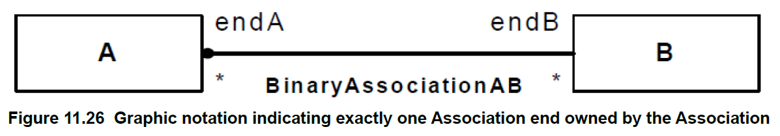

Slide 4
Notacja (11.5.4)
An Association symbol may be adorned as follows:
The Association’s name can be shown as a name string near the Association symbol, but not near enough to an end to be confused with the end’s name.
A slash appearing in front of the name of an Association, or in place of the name if no name is shown, marks the Association as being derived.
A property string may be placed near the Association symbol, but far enough from any end to not be confused with a property string on an end.

Slide 5
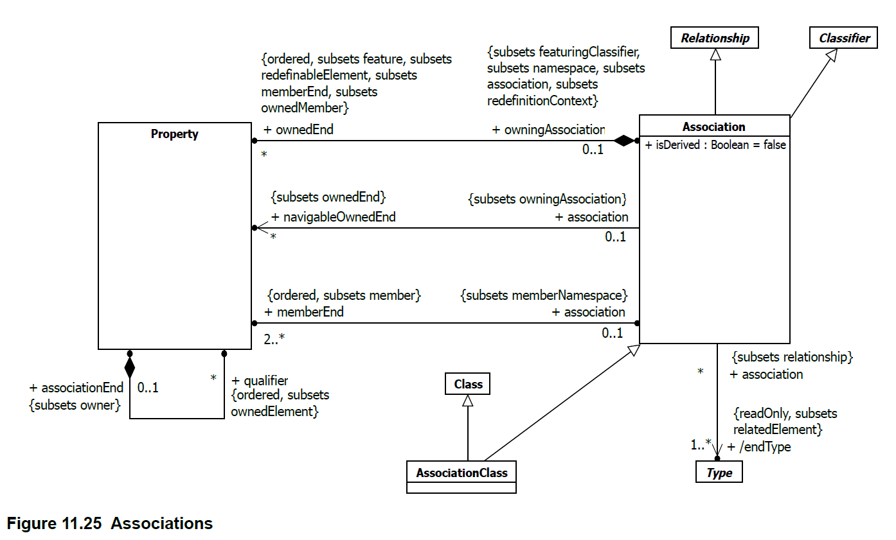

Slide 6
